Slide 1

Implementation And Architecting Cloud Web Infrastructures
Batch – 15
Guide:
Dr.V.NAGESH
Professor
Team:
20331A1293-P.Laxmi Narayana
20331A1297-P.S.V.Sougandhika
20331A1278-Mohammad Zakir Ahmed
DEPARTMENT OF INFORMATION TECHNOLOGY
MAHARAJ VIJAYARAM GAJAPATHI RAJ COLLEGE OF ENGINEERING (A)

Slide 2
Introduction
Outlines of the Presentation
Introduction
Project Abstract
Problem Statement
Present System
Proposed System
Hardware and Software Requirements
Architecture Diagrams
Network Flow Diagram
DNS Records
Result Analysis

Slide 3
Introduction
In our project, we explore the dynamic realm of multi-tier cloud-based architectures, traversing 1-tier, 2-tier, and 3-tier systems. Leveraging AWS resources like EC2 instances, EFS, RDS, and PHP, we meticulously examine the limitations of lower-tier structures, paving the path towards the complexities of 3-tier setups. Employing load balancing and auto-scaling strategies, we adeptly manage traffic fluctuations, while EFS and RDS offer scalable storage and database solutions, complemented by PHP's role in web server deployment. Ensuring unwavering high availability through redundancy across EC2 instances, RDS replication, and EFS storage, our project serves as a guide for crafting resilient web applications in the dynamic landscape of multi-tier cloud environments, merging cloud excellence with architectural finesse. Welcome to the intersection of cloud mastery and application artistry.

Slide 4
Project Abstract
The project explores multi-tier architectures, encompassing 1-tier, 2-tier, and 3-tier configurations, utilizing AWS resources including EC2 instances, Elastic File System (EFS), Relational Database Service (RDS), and PHP. We commence with 1-tier and 2-tier architectures to grasp limitations, then advance to 3-tier architecture, integrating load balancing and auto scaling for efficient handling of traffic spikes. EFS and RDS offer scalable storage and database services, while PHP facilitates web application development, server-side processing, and API development. High availability is ensured through redundancy in EC2 instances, RDS database replication, and EFS distributed file storage. This project serves as a valuable guide for crafting robust, efficient, and highly available web applications in multi-tier cloud environments.

Slide 5
Problem Statement
To design and implement 1-tier, 2-tier and 3-tier cloud web architectures, along with load balancing to ensure application scalability through orchestration techniques, as well as high availability and disaster recovery mechanisms to guarantee reliability and resilience in our architectures.

Slide 6
Present System
The current system features a mix of 1-tier, 2-tier, and 3-tier architectures, each lacking load balancers and auto scaling mechanisms. In 1-tier, all components reside within a single server, while 2-tier separates application logic and data storage layers across two servers. Transitioning to 3-tier introduces an additional layer for presentation separation. Despite the tiered structure, the absence of load balancers and auto scaling hinders efficient traffic distribution and resource adaptation, risking downtime during server failures. While the existing setup lays a foundation, integrating load balancing and auto scaling is imperative for scalability, reliability, and performance.

Slide 7
Proposed System
In our proposed system, we address the limitations of traditional 1-tier, 2-tier, and 3-tier architectures by integrating dynamic load balancing and auto scaling through Amazon Web Services (AWS). Leveraging PHP alongside AWS, we develop responsive web applications that can scale seamlessly to meet fluctuating workloads. Disaster recovery mechanisms, utilizing AWS's multi-region capabilities, ensure uninterrupted service by redirecting traffic during system failures. Proactive health checks enable swift responses to maintain high availability and reliability. This holistic approach allows us to build a resilient infrastructure that effectively mitigates risks and meets the demands of modern applications.

Slide 8
Hardware & Software Requirements
Hardware Requirements
EC2
EFS
RDS
Load Balancer
Software Requirements
PHP
Maria DB
MYSQL Client
Apache Server

Slide 9
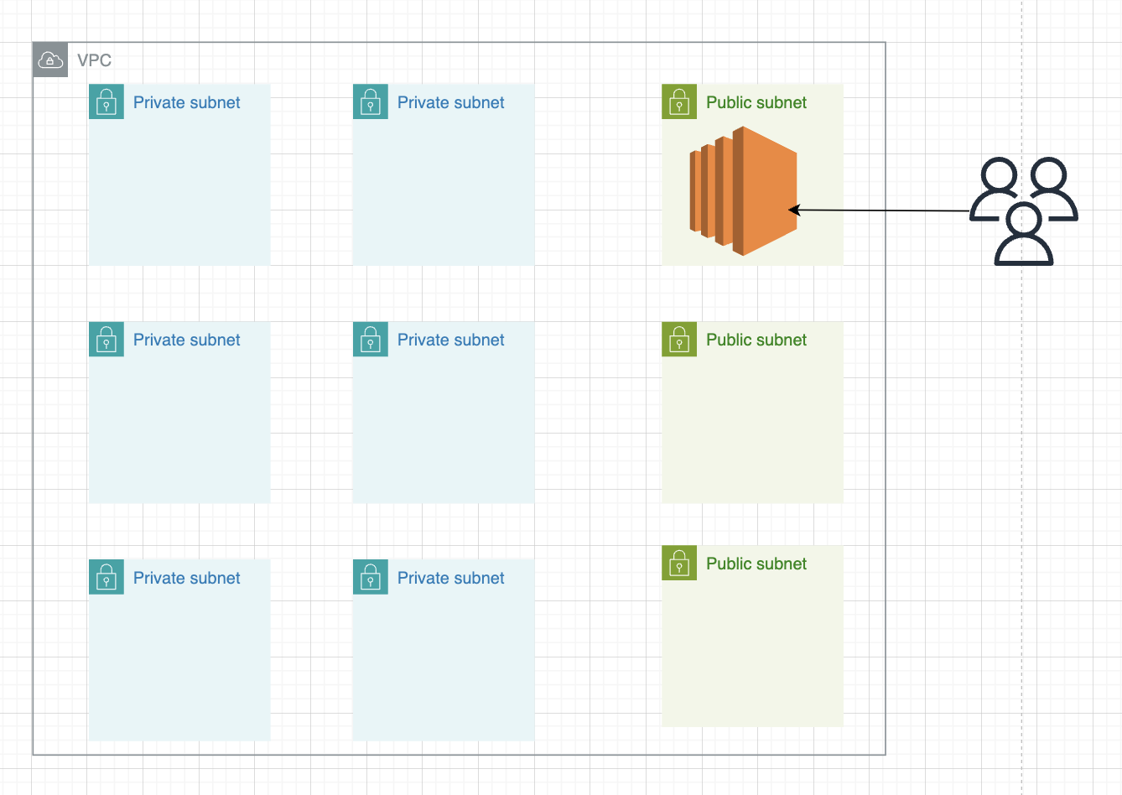
Architecture Diagrams
1-tier

Slide 10
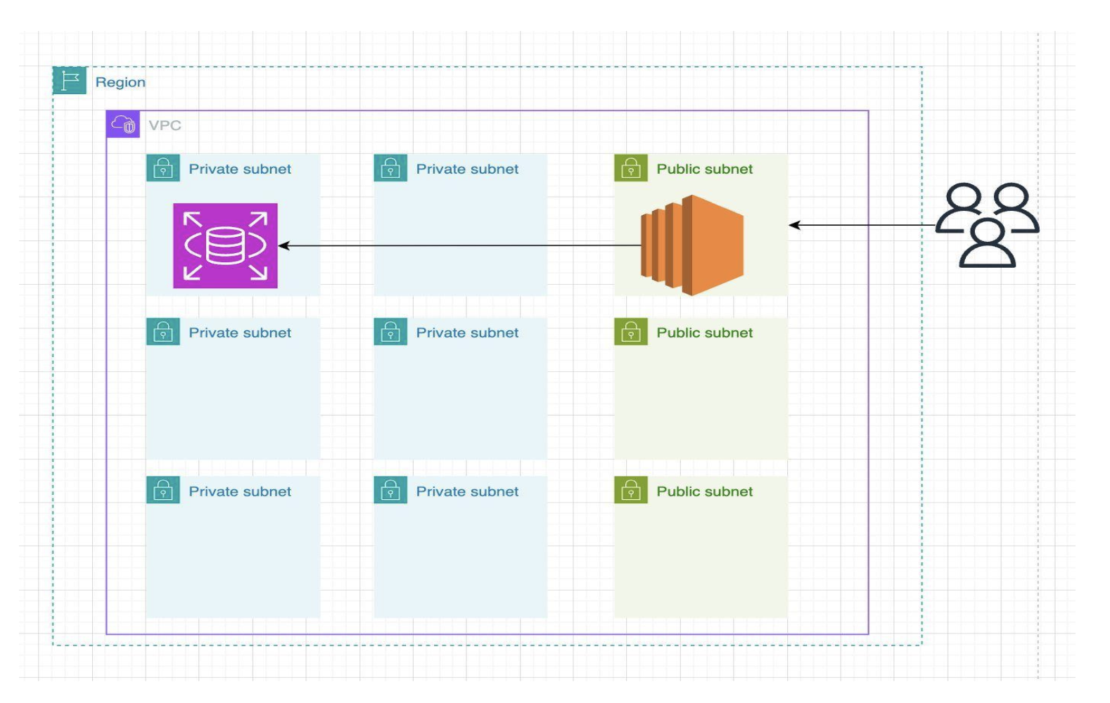
Architecture Diagrams
2-tier

Slide 11
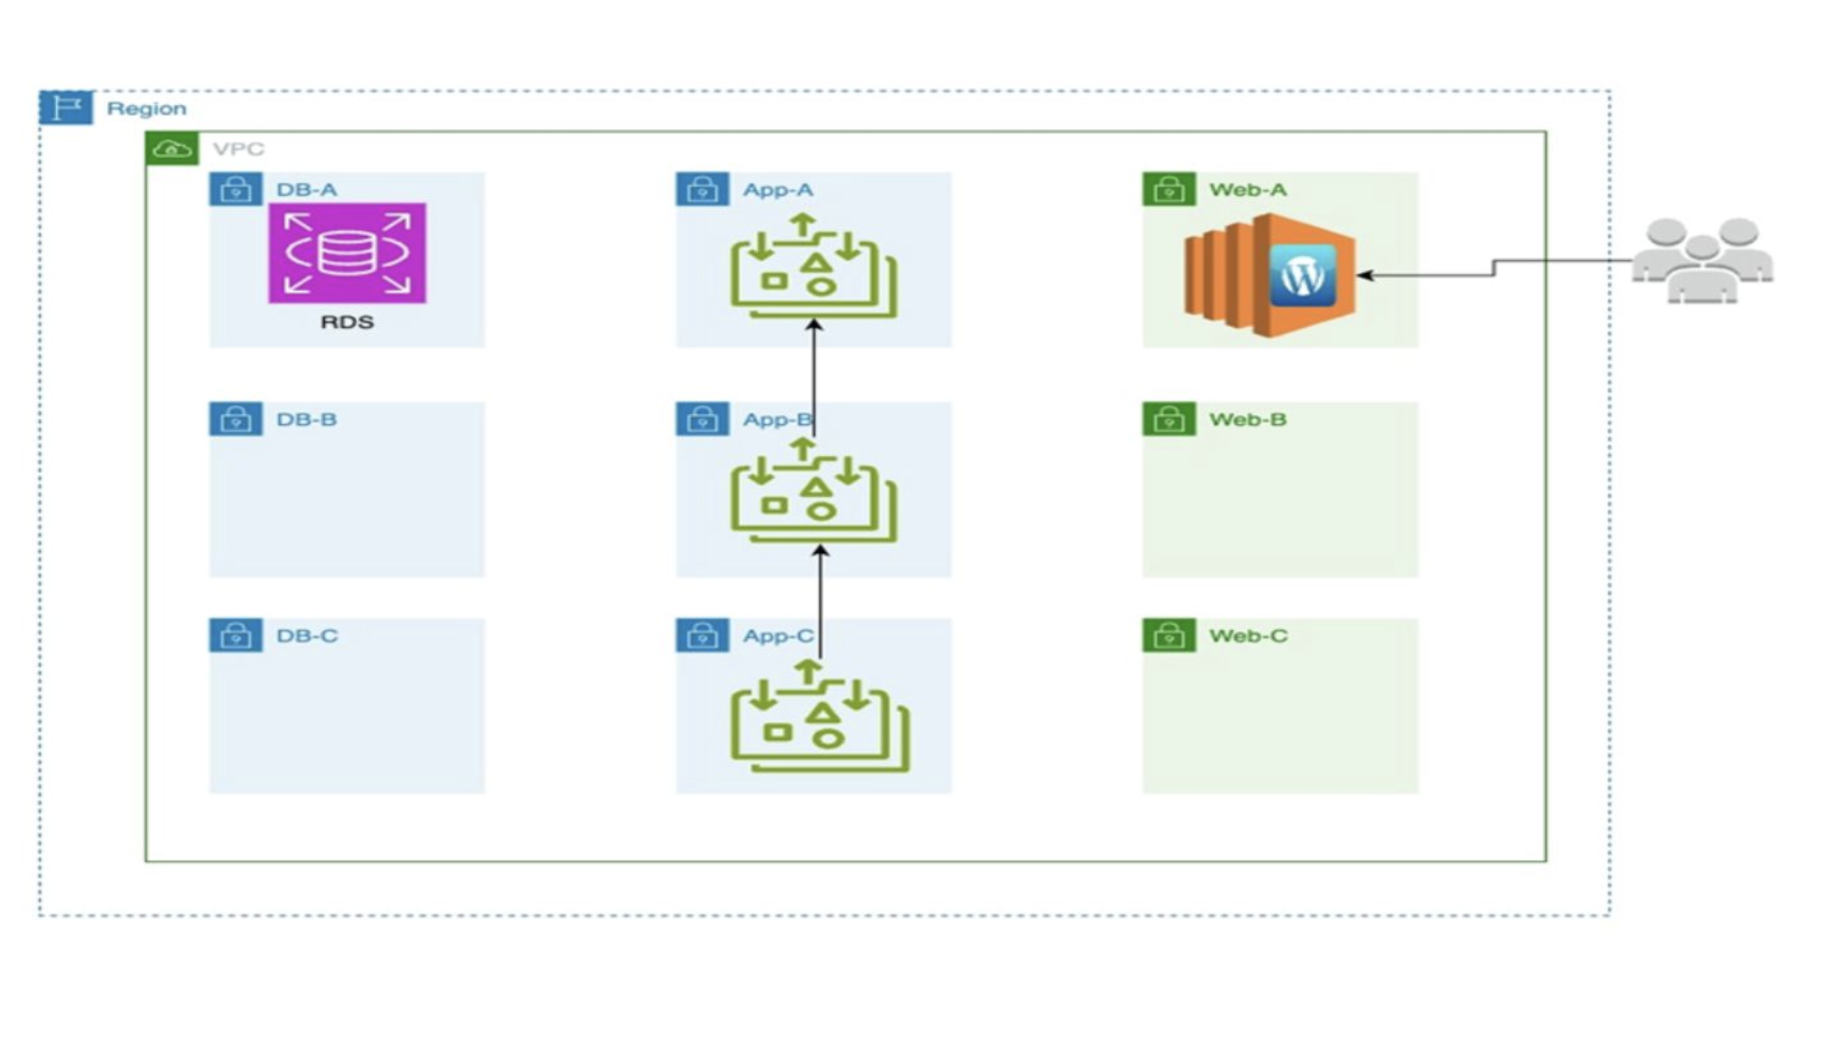
Architecture Diagrams
3-tier

Slide 12
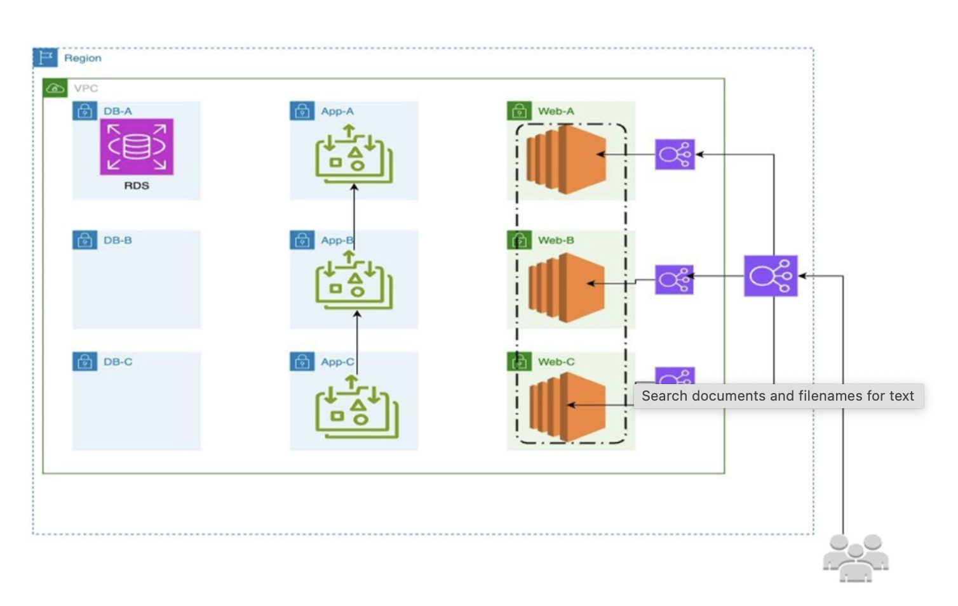
Architecture Diagrams
3-tier with auto scaling and Load balancing

Slide 13
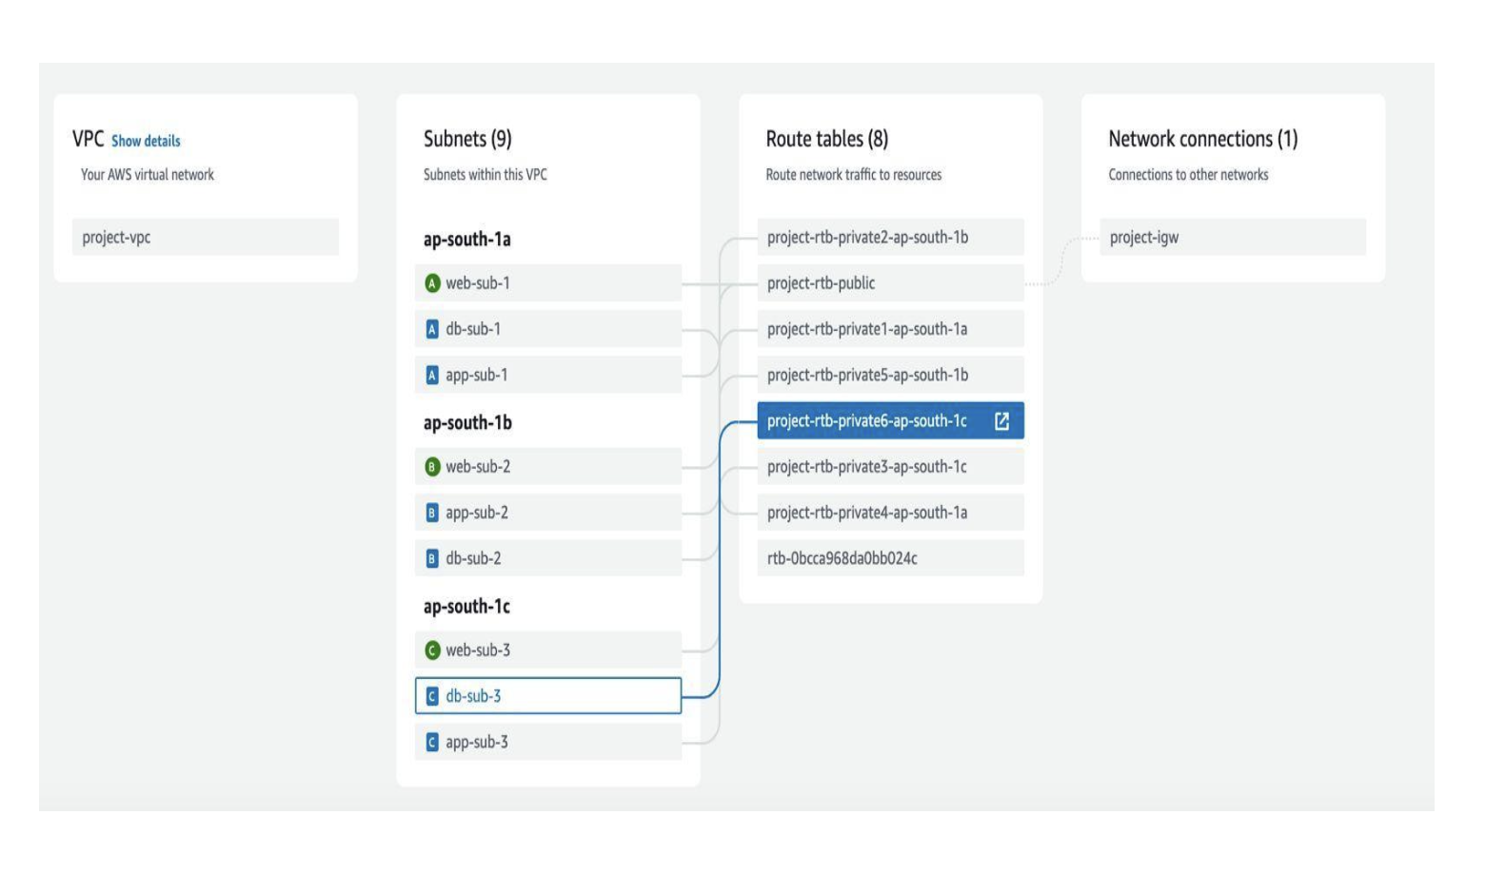
Network Flow Diagram

Slide 14
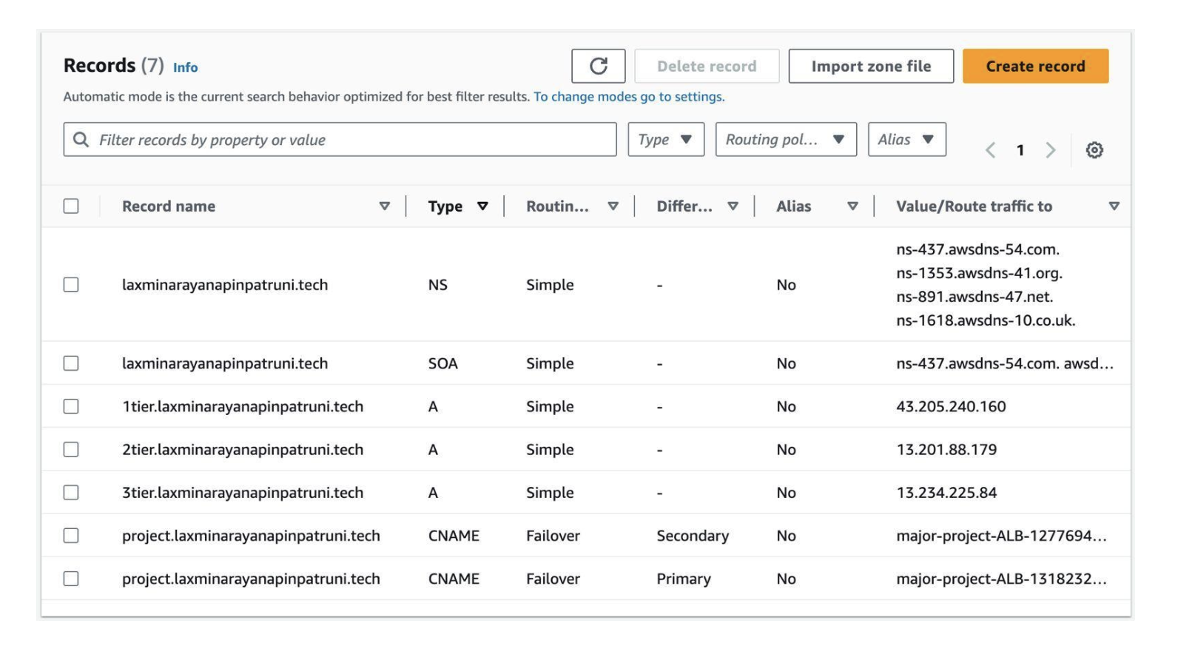
DNS Records

Slide 15
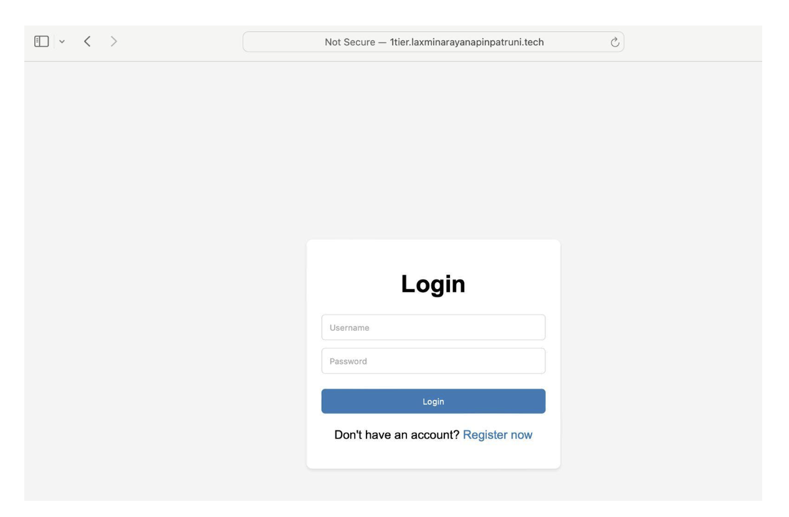
Result Analysis
Login Page

Slide 16
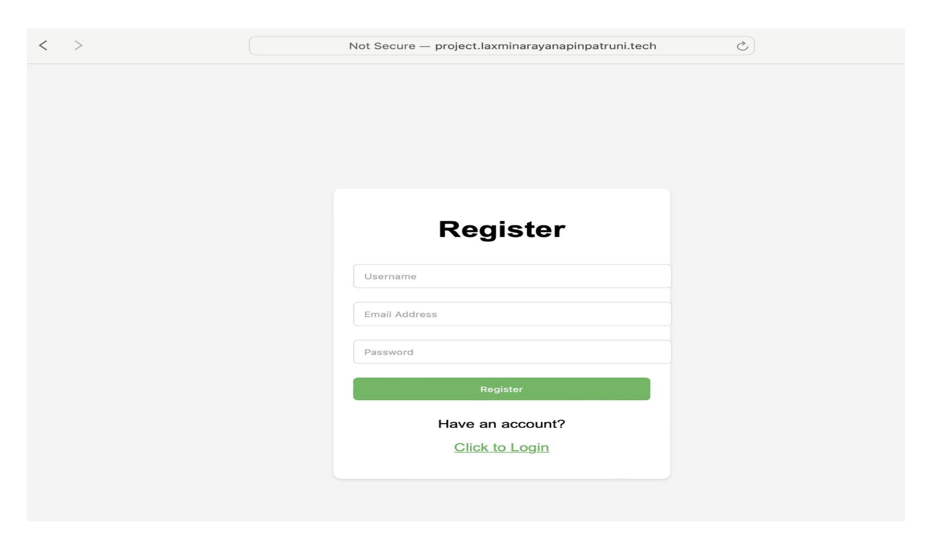
Result Analysis
Registration Page

Slide 17
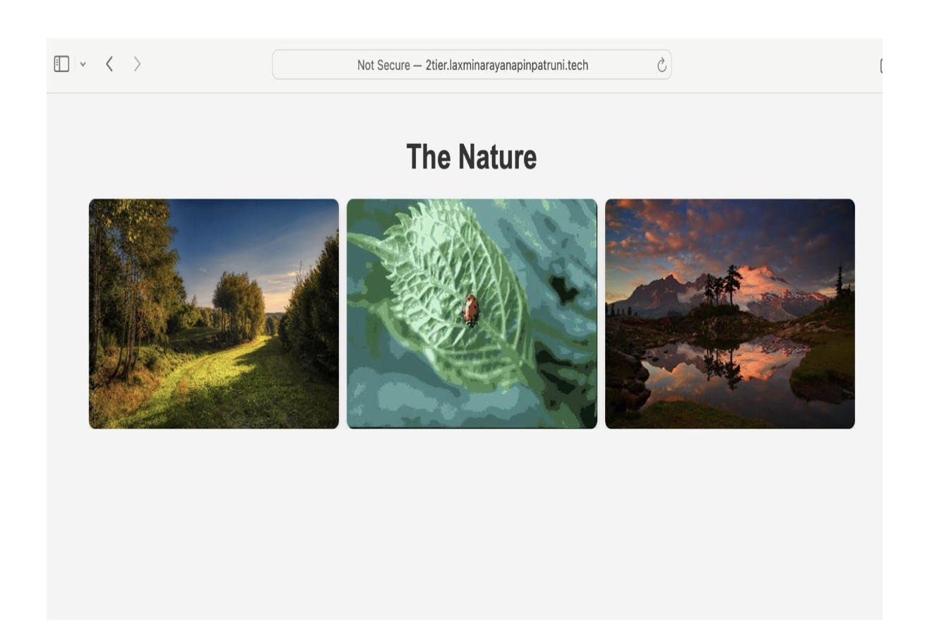
Result Analysis
Home page

Slide 18
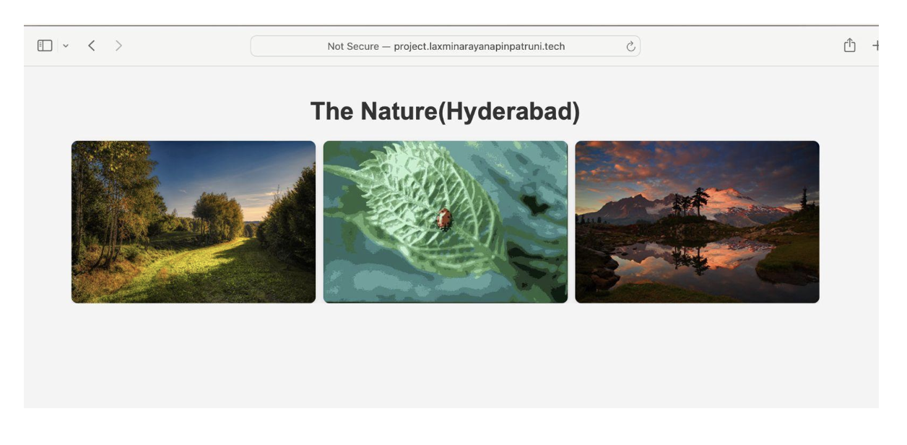
Result Analysis
Primary Site

Slide 19
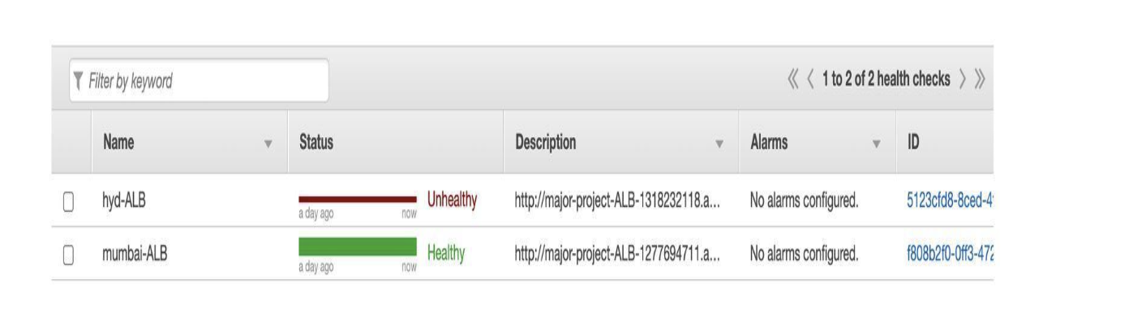
Result Analysis
Route 53 Health Checks

Slide 20
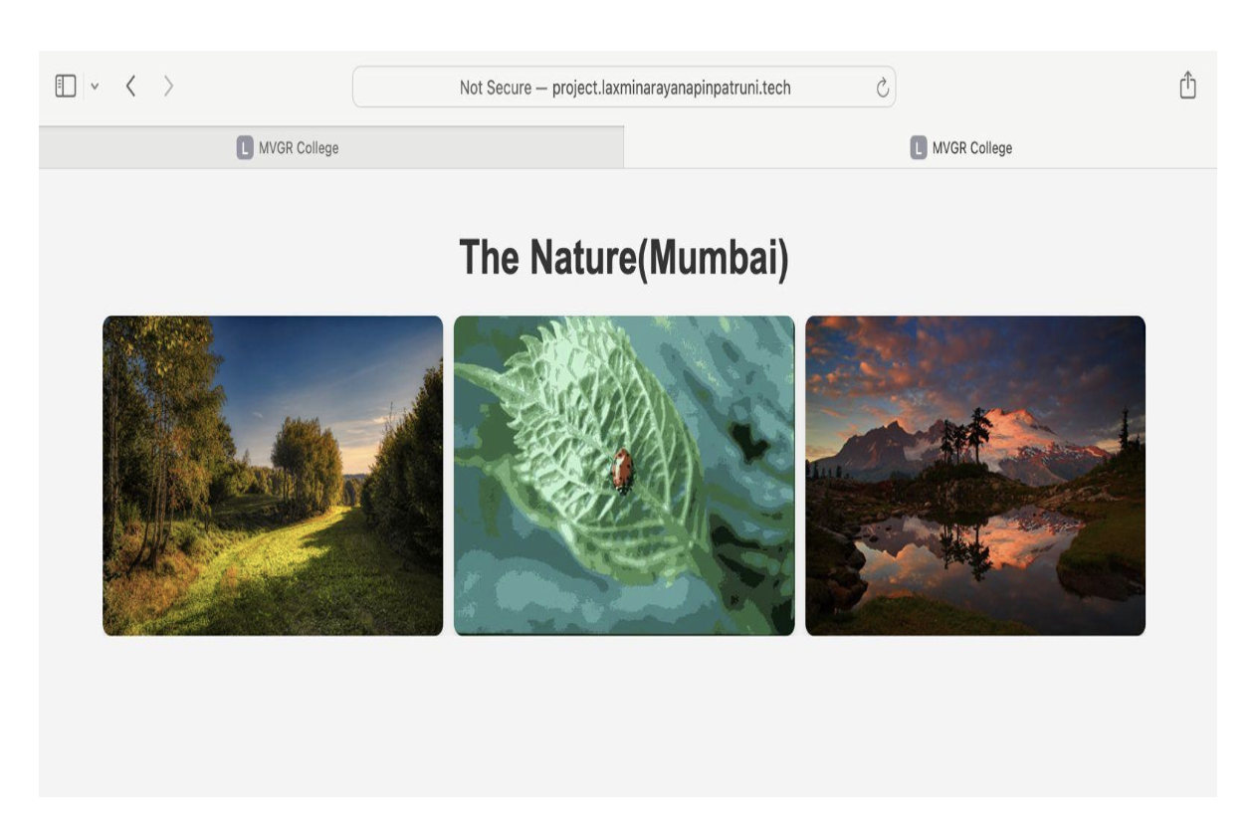
Result Analysis
Secondary Site

Slide 21
Conclusion
Our journey from 1-tier to 3-tier architectures utilizing AWS resources and PHP has been transformative, addressing scalability and fault tolerance limitations of traditional architectures. Starting with 1-tier, we progressed through 2-tier, noting improvements but lacking scalability. Finally, transitioning to 3-tier with load balancing and auto-scaling enabled efficient traffic handling and high availability. AWS services like EC2, EFS, and RDS facilitated scalable storage and database solutions, while PHP empowered server- side processing. This evolution exemplifies the shift towards cloud-native solutions, setting the stage for resilient, agile, and scalable systems capable of meeting modern web application demands. Through strategic use of cloud infrastructure and PHP, we've laid a foundation for future-ready architecture in dynamic digital environments.

Slide 22
References
http://ieeexplore.ieee.org/document/6779898
https://ieeexplore.ieee.org/document/5598055
https://www.researchgate.net/publication/332828653_Research_on_Auto-
Scaling_of_Web_Applications_in_Cloud_Survey_Trends_and_Future_Directions
http://ieeexplore.ieee.org/document/5988838
https://www.researchgate.net/publication/297047540_A_survey_of_quality_of_service_in_mult i-tier_web_applications
https://ieeexplore.ieee.org/document/7463864
https://ieeexplore.ieee.org/document/8757549

Slide 23
Thank You
Thank You

